Slide 1
NEWS TODAY WEBSITE
Presented by
DIVYA BHORIA 2210990293
GEETANSH SOOD 2210990323
OJAS GUPTA 2210990627
Under the supervision of
PARUL GAHELOT
Department of Computer Science and Engineering
Chitkara University Institute of Engineering & Technology,
Chitkara University, Punjab

Slide 2
Introduction
Problem Statement-In today's digital landscape, the abundance of news websites makes it challenging for individuals to stay informed while ensuring reliability and avoiding bias. Navigating multiple sources is time-consuming, and misinformation is a growing concern. Thus, there's a pressing need for a centralized news website that aggregates top stories from reputable sources. This platform would offer convenience, promote media literacy, and provide users with reliable, diverse news coverage, addressing the challenges of information overload and misinformation.
Solution: We’ve come up with an idea to build a NEWS TODAY WEBSITE which will will focus on
1.Information Overload: Users struggle to navigate multiple news websites, leading to time-consuming searches and difficulty staying updated.
2.Reliability Concerns: Sorting through various sources makes it challenging to discern trustworthy information from biased or unreliable sources.
3. Misinformation: The proliferation of fake news and misinformation on the internet undermines the public's ability to access accurate information.

Slide 3
Introduction
4. Lack of Convenience: Users seek a consolidated platform for accessing news without having to visit multiple websites.
5.Media Literacy: Many individuals lack the skills to critically evaluate news sources, leading to susceptibility to false narratives and misinformation.

Slide 4
Motivation of Research
The motive behind this research is driven by the growing challenges faced in accessing reliable and diverse news sources in today's digital age. With an abundance of online platforms offering news content, individuals often encounter information overload, reliability concerns, and the spread of misinformation. Recognizing the importance of staying informed and the need for a convenient solution, this research aims to address these challenges by proposing the development of a centralized news website. By aggregating top news stories from reputable sources, prioritizing credibility, and promoting media literacy, the goal is to empower users with a trusted platform that provides easy access to accurate and diverse news coverage. Ultimately, the motive behind this research is to enhance the public's ability to stay informed, critically evaluate news sources, and navigate the complex landscape of digital information with confidence and clarity.

Slide 5




Tools & Technologies
Tools & Technologies
1 . HTML (Hypertext Markup Language)
- Foundation of web development for structuring content on a webpage.
- Utilizes tags to define elements such as headings, paragraphs, images, and links.
- Provides the basic structure for creating web pages and is essential for building the user interface.
2. CSS (Cascading Style Sheets)
- Stylesheet language used for describing the presentation of a document written in HTML.
- Enables the separation of content and presentation, allowing for consistent styling across multiple pages.
- Includes selectors, properties, and values to define the visual appearance, layout, and design of HTML elements.
3. React JS
- Component-Based Architecture: React facilitates the creation of interactive user interfaces through a modular, component-based
approach, enhancing code reusability and maintainability.
- Virtual DOM and Efficient Rendering: React's virtual DOM efficiently updates the UI, minimizing re-renders and optimizing performance for
faster page loads and smoother user interactions.
4. Tailwind CSS
- Utility-first CSS framework designed to streamline the styling process.
- Utilizes pre-defined utility classes for common styles, reducing the need for custom CSS.
- Offers a modular and highly customizable approach to styling, facilitating rapid development and consistent design patterns.

Slide 6



Tools & Technologies
5. SVG Repo: SVG Repo offers a diverse collection of scalable vector graphics (SVG) files, providing designers and developers with high-quality icons and illustrations for web design and digital projects.
6. Google Fonts: Google Fonts is a free library of web fonts curated by Google, offering a wide selection of high-quality fonts to enhance typography and readability in web projects with easy integration and customization options.
7. Tailblocks (Template): Tailblocks provides pre-designed HTML and CSS components built with Tailwind CSS, enabling developers to quickly prototype and build modern-looking websites and applications with customizable, responsive templates.

Slide 7
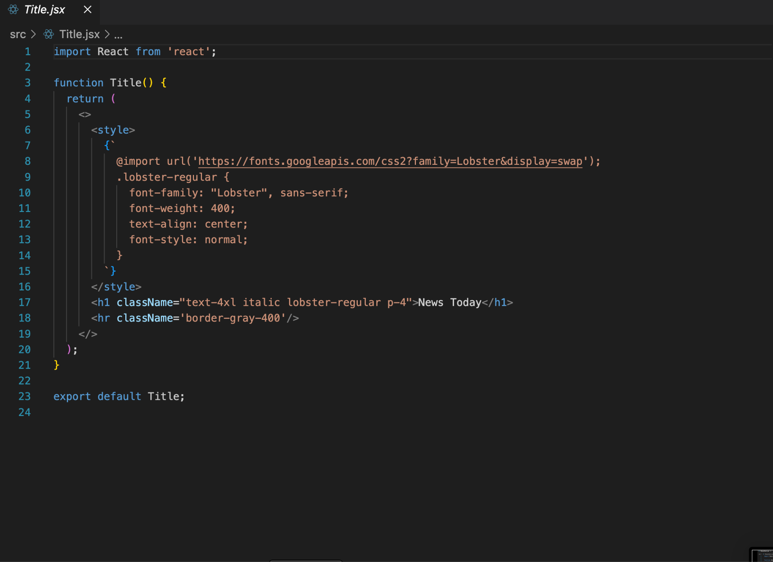
Code Snapshots

Slide 8
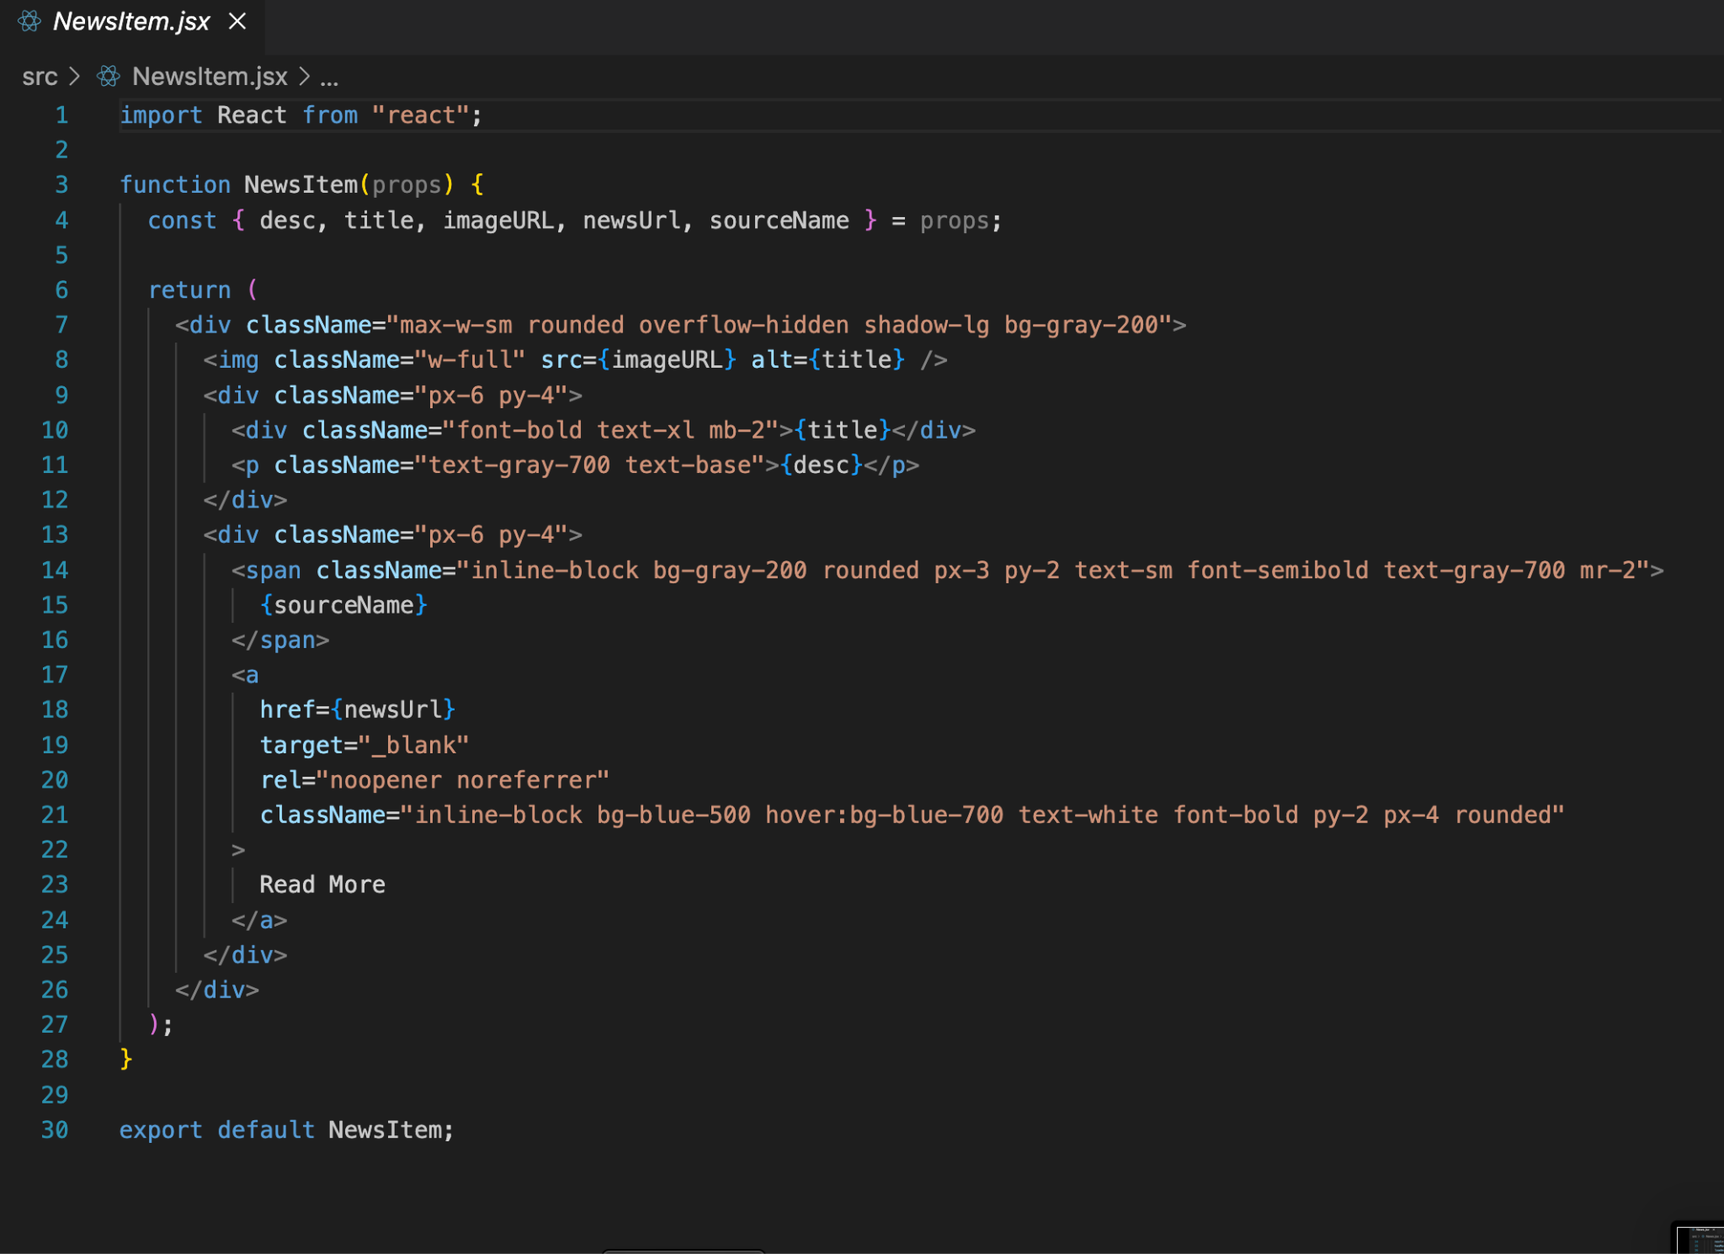
Code Snapshots

Slide 9
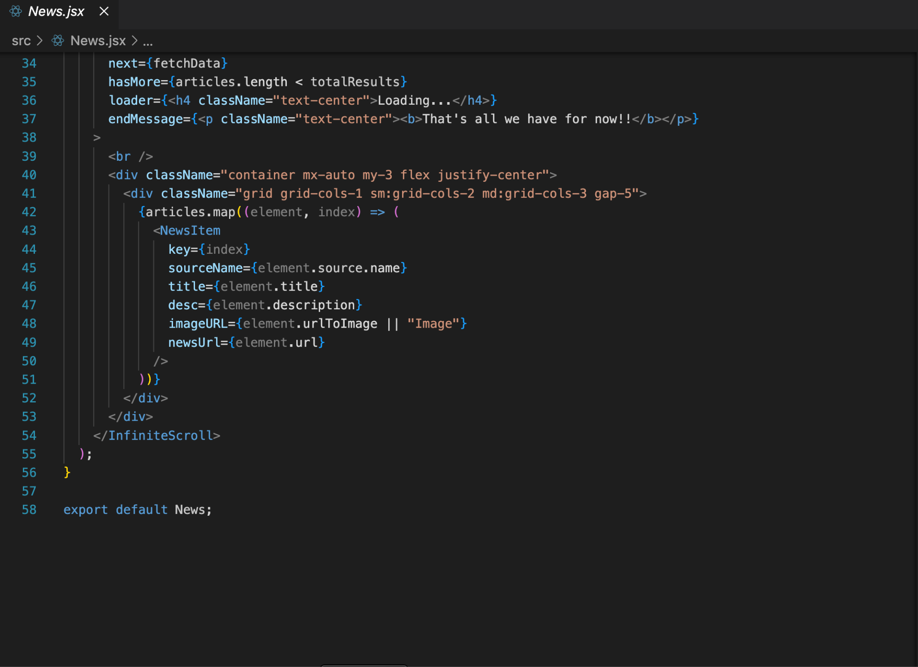
Code Snapshots

Slide 10
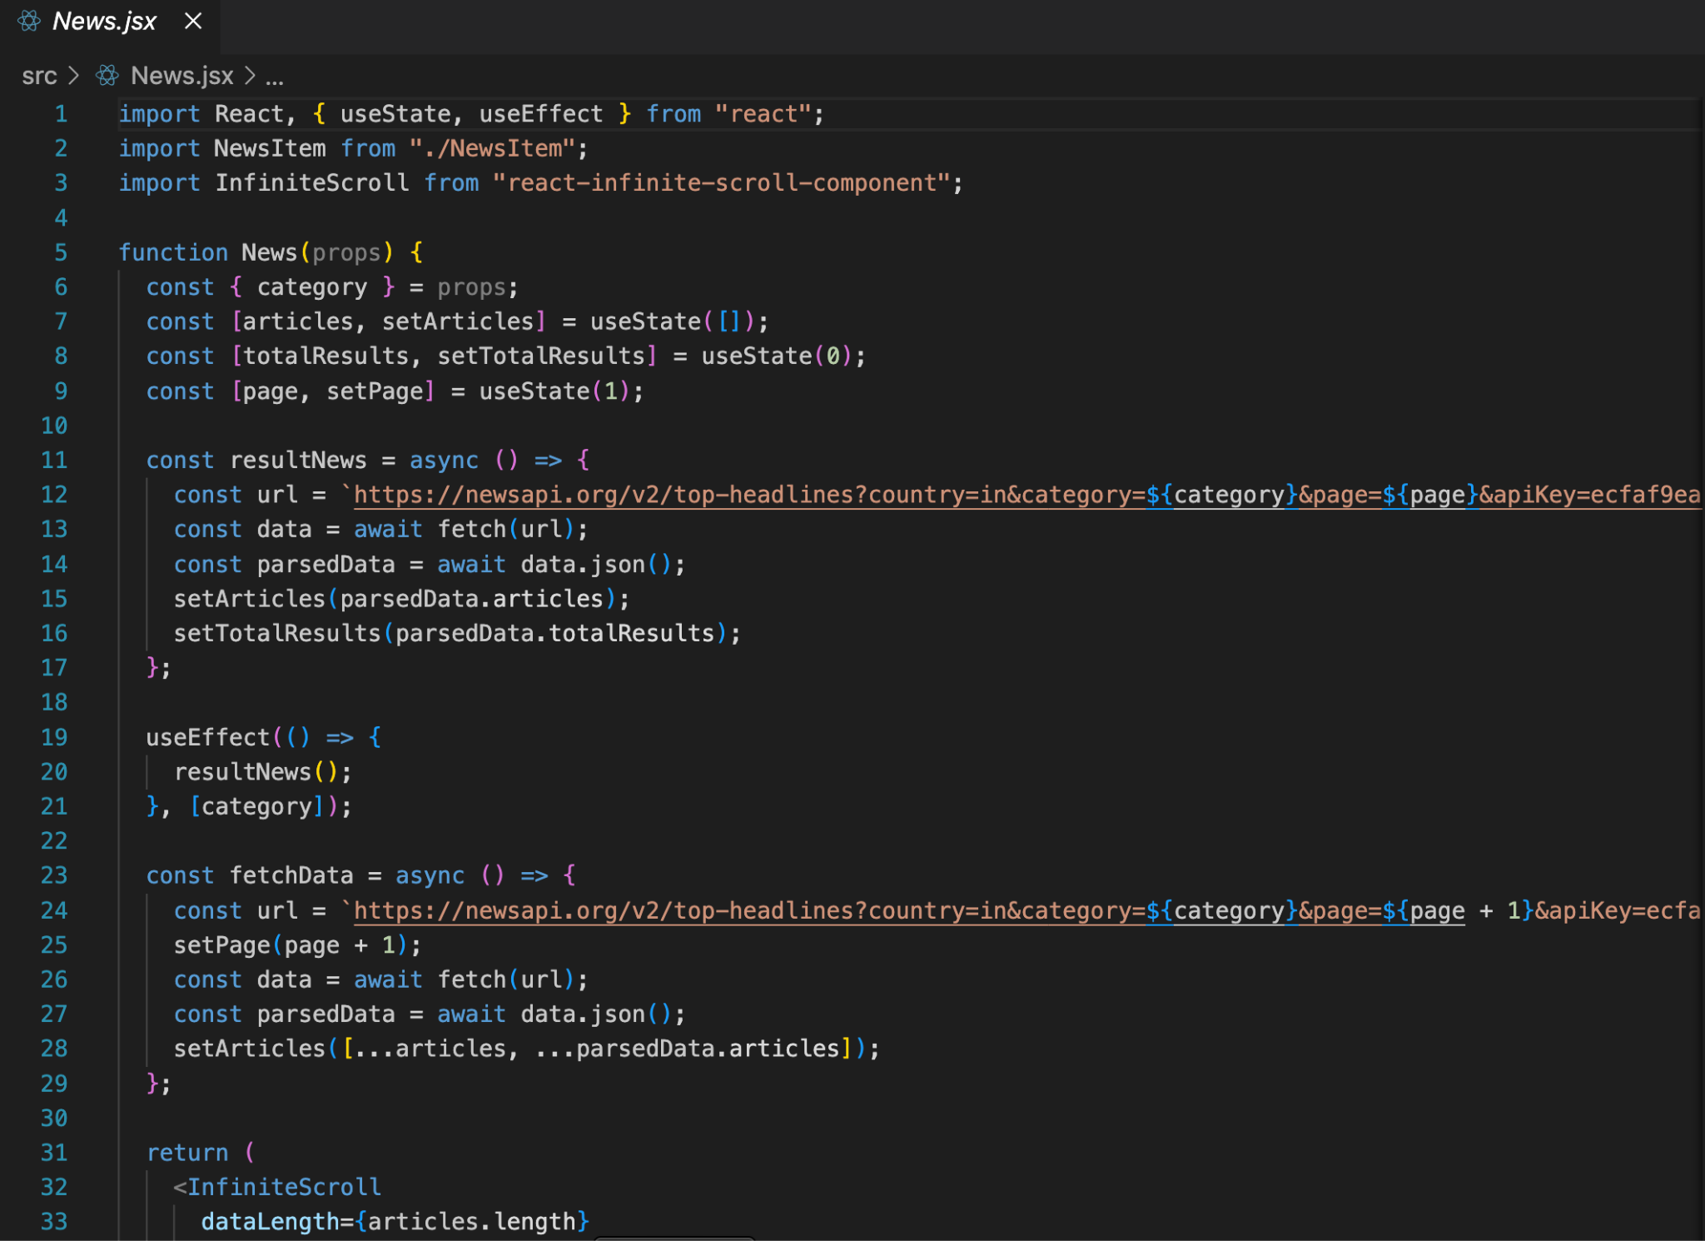
Code Snapshots

Slide 11
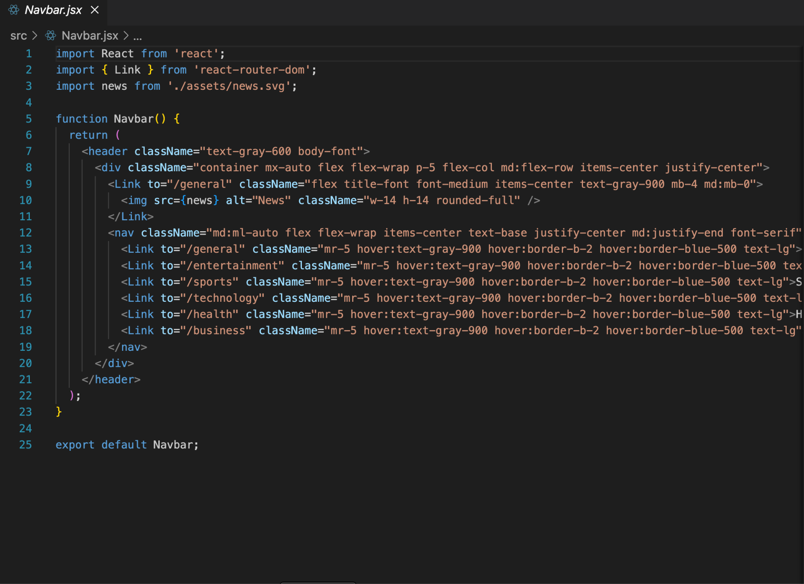
Code Snapshots

Slide 12
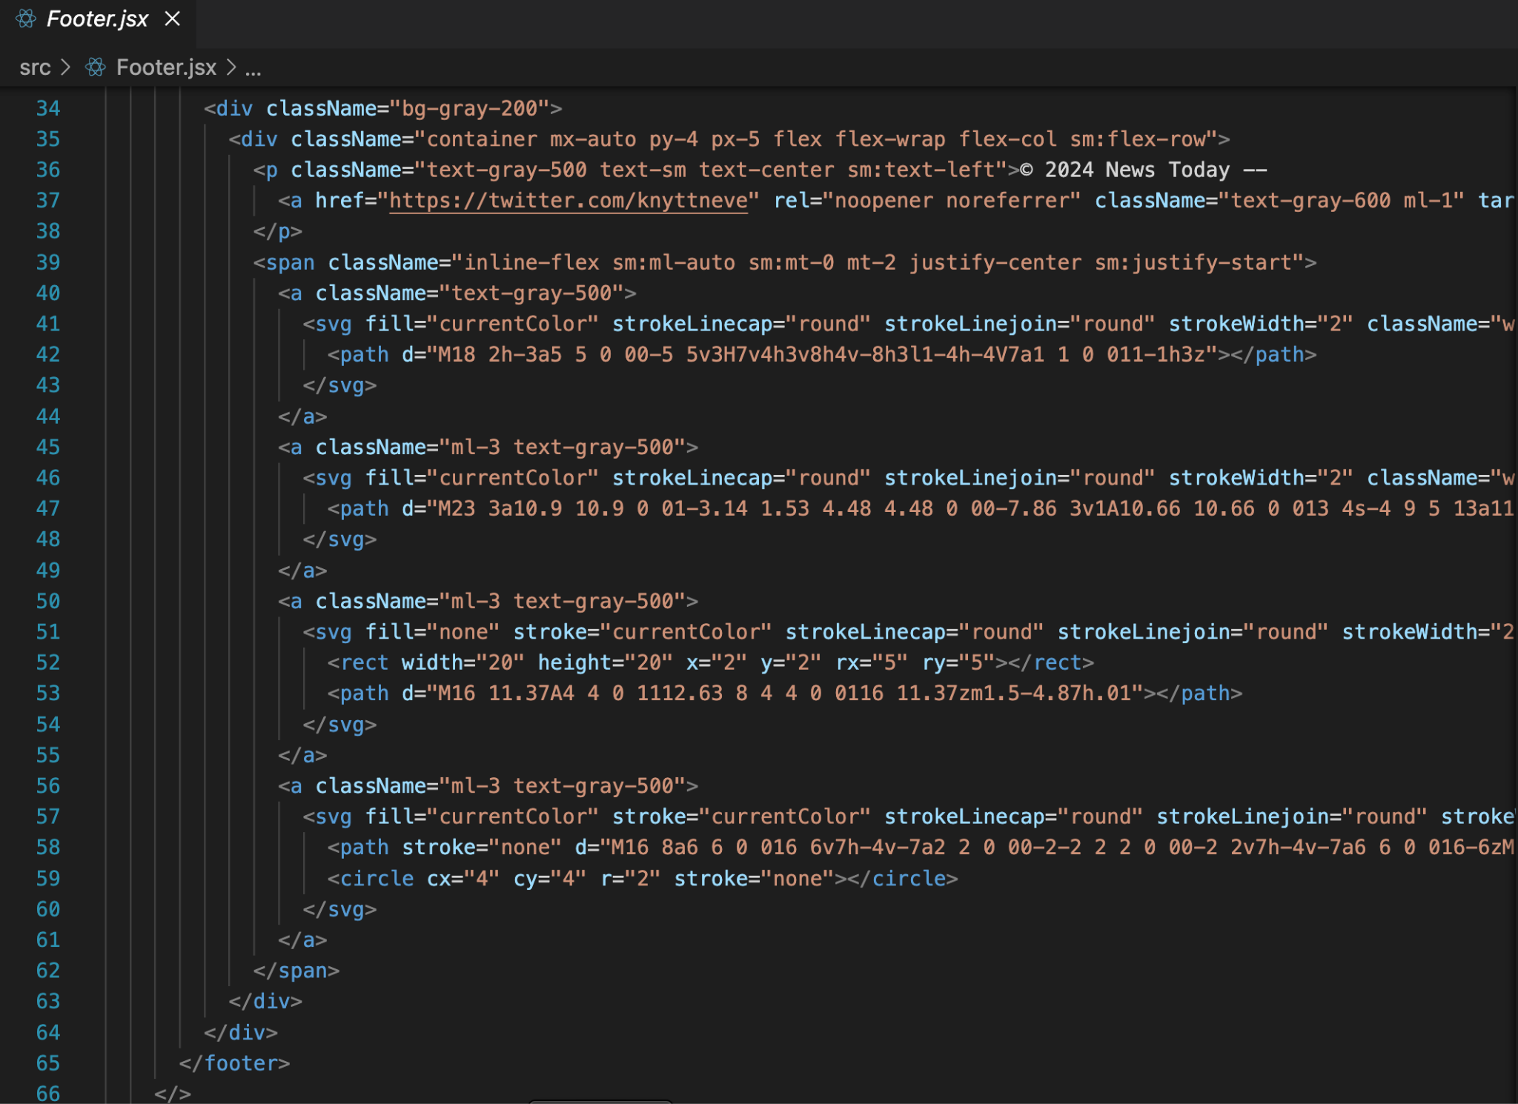
Code Snapshots

Slide 13
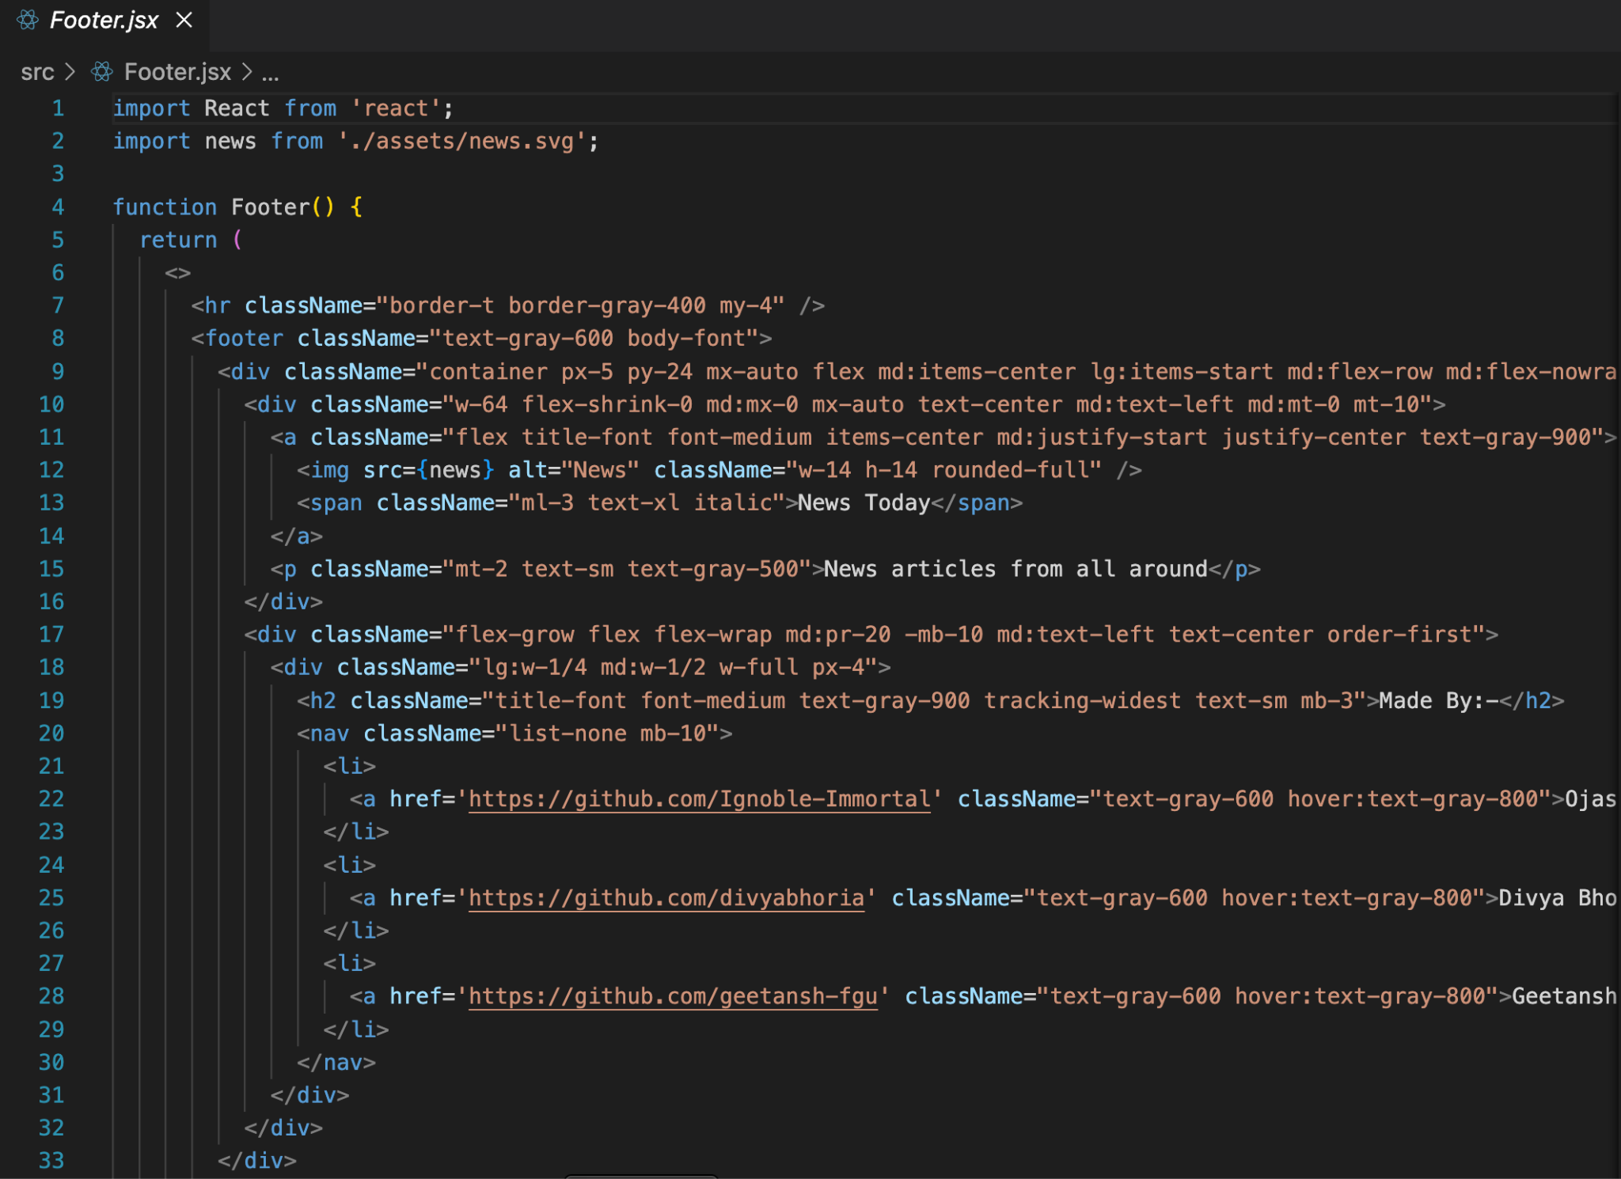
Code Snapshots

Slide 14
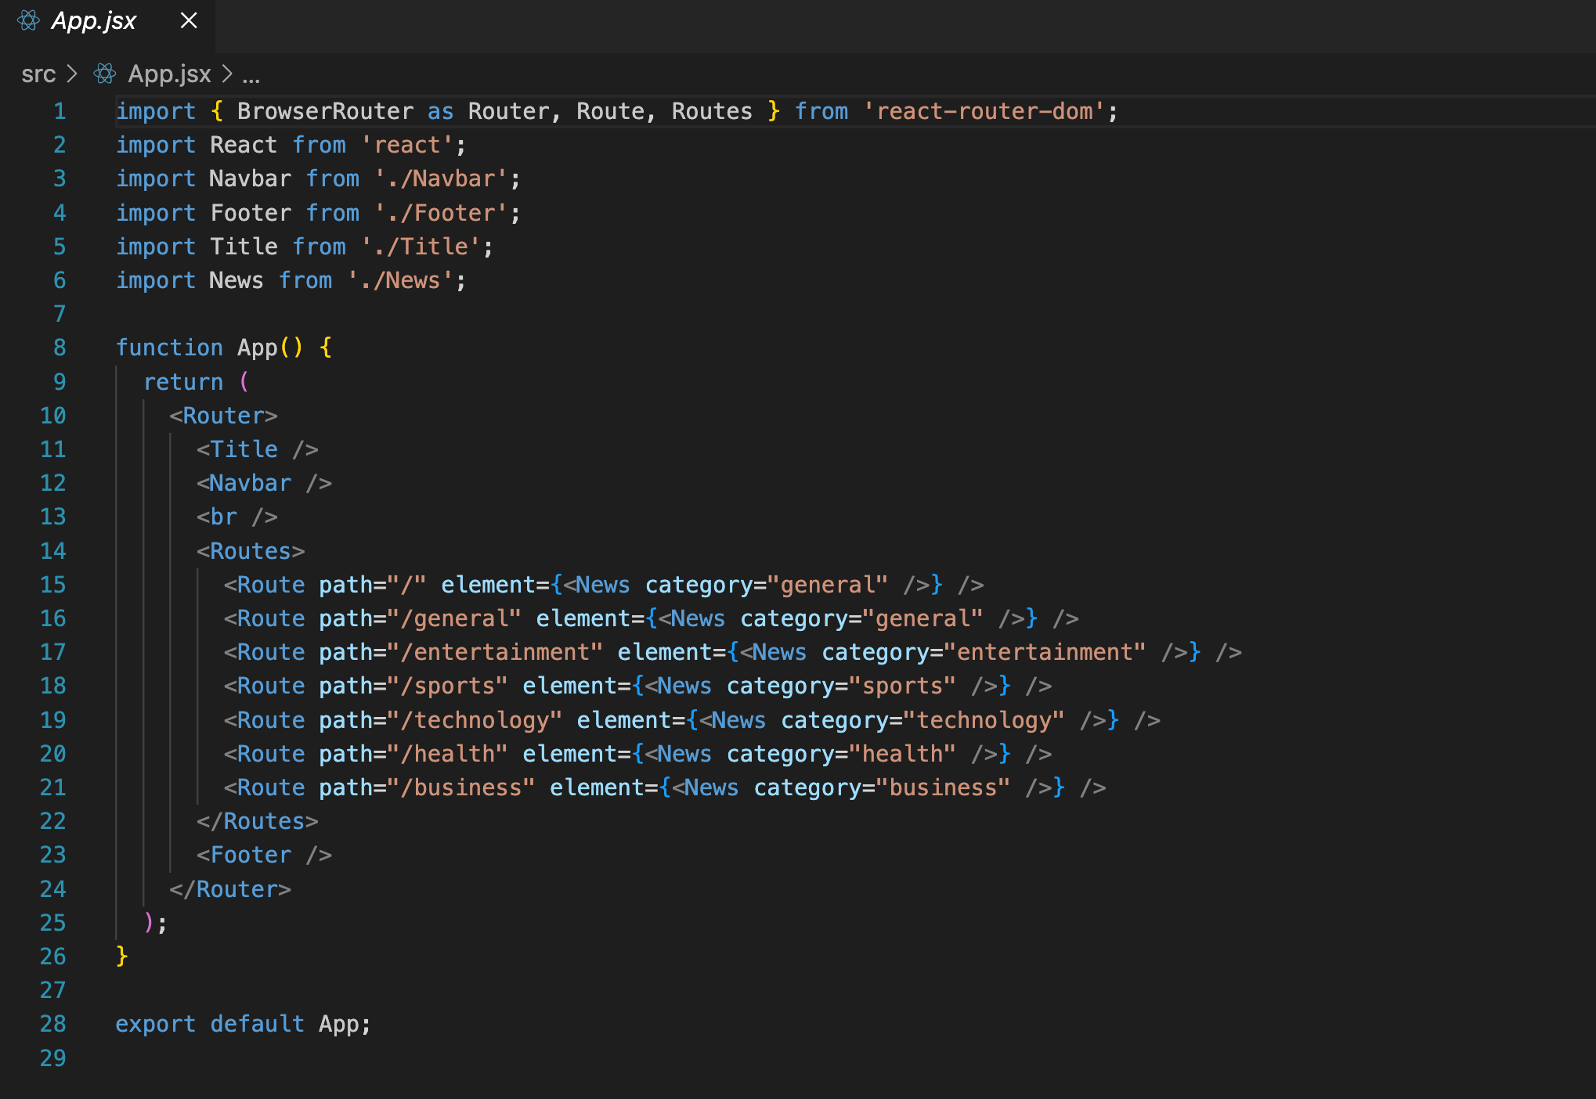
Code Snapshots

Slide 15
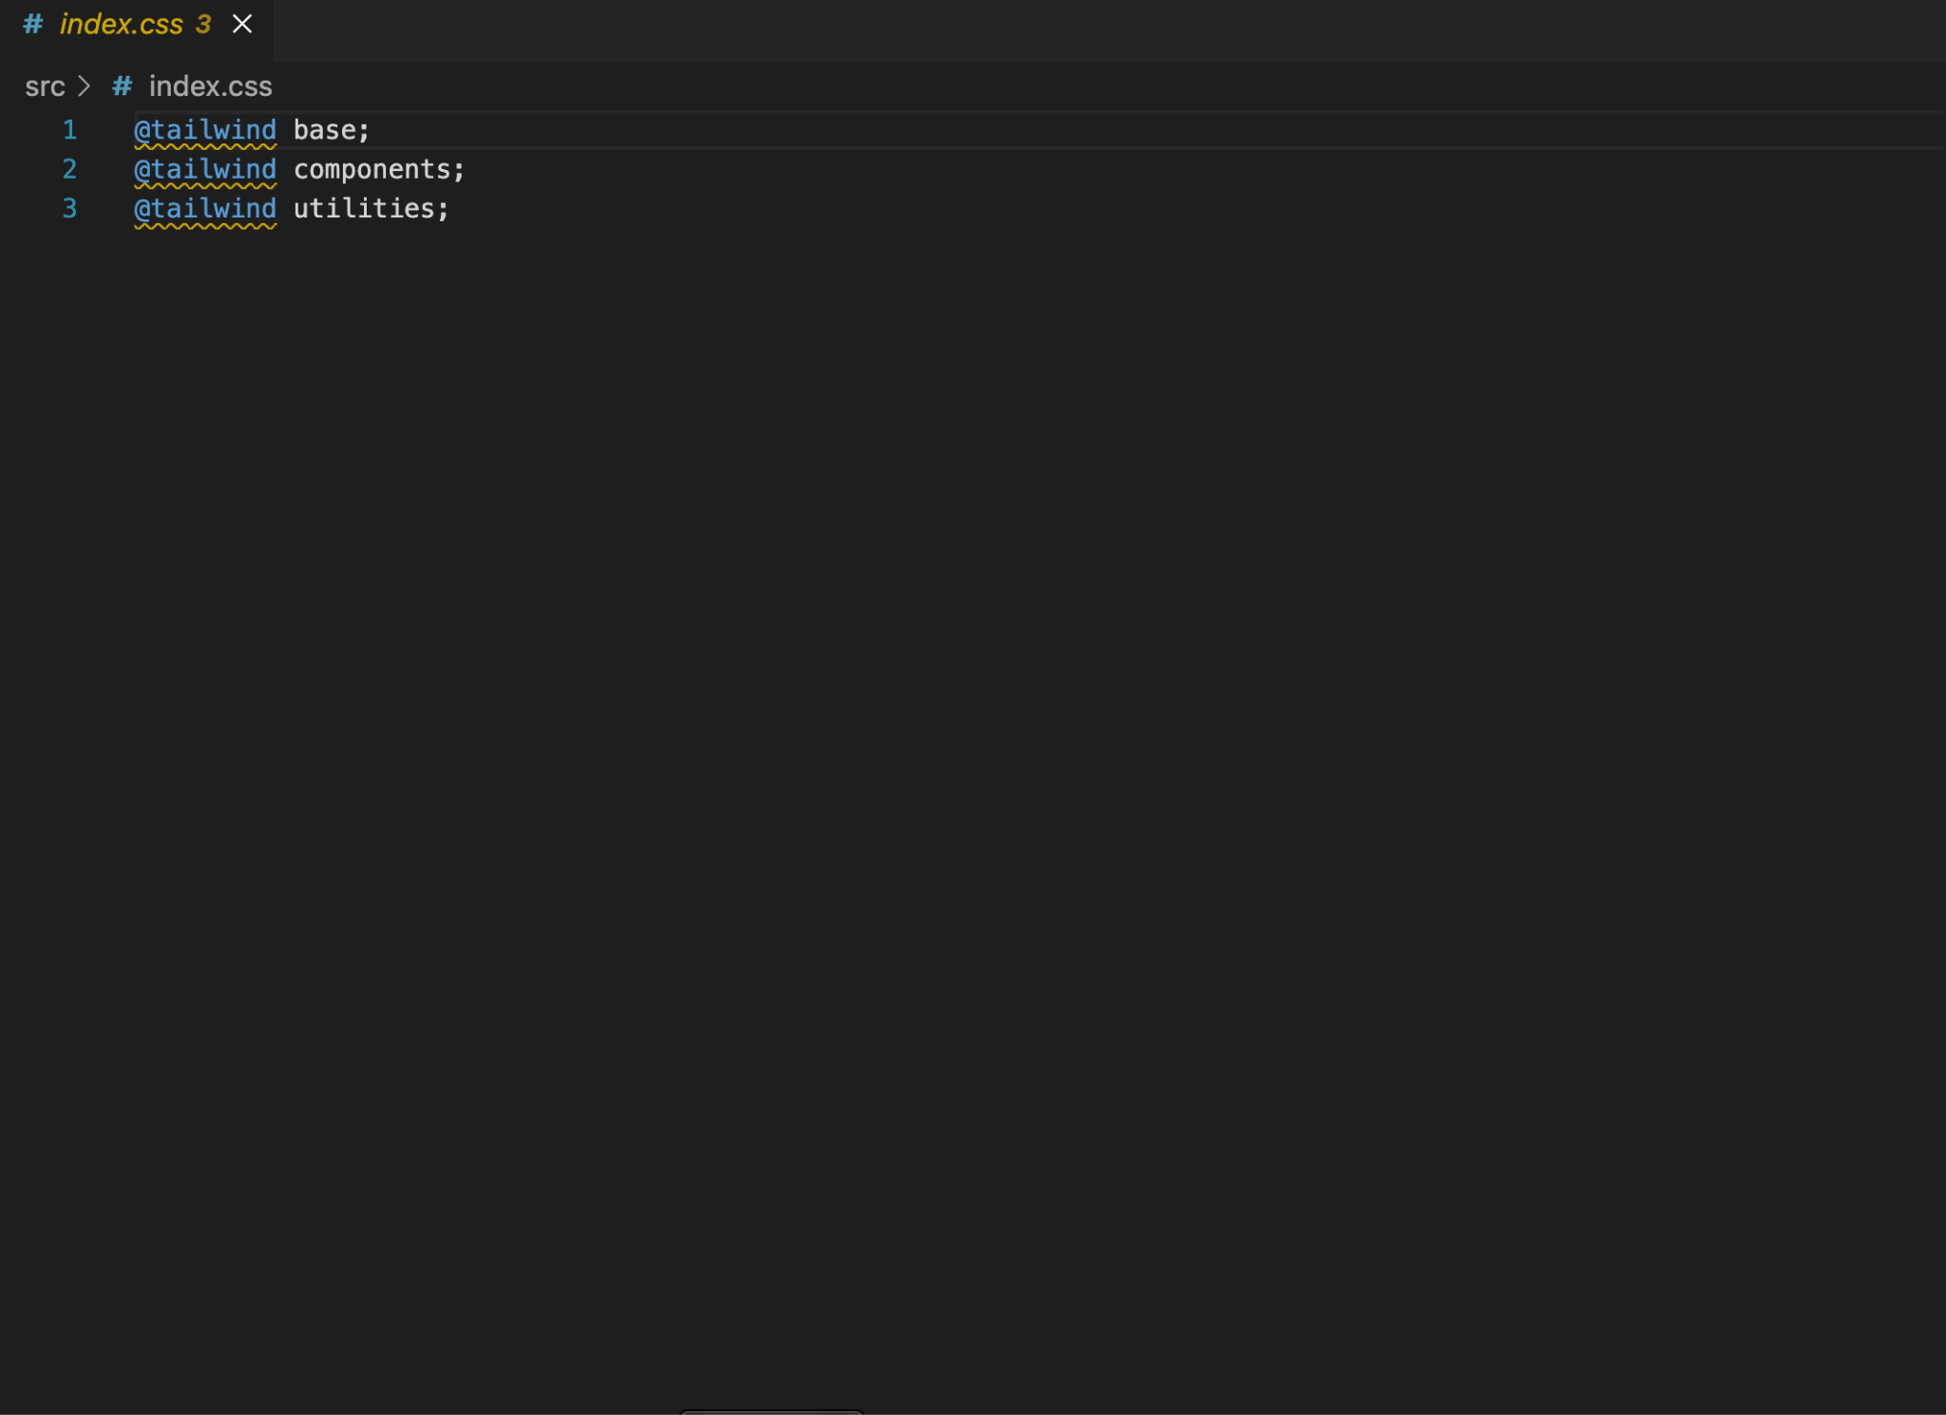
Code Snapshots

Slide 16
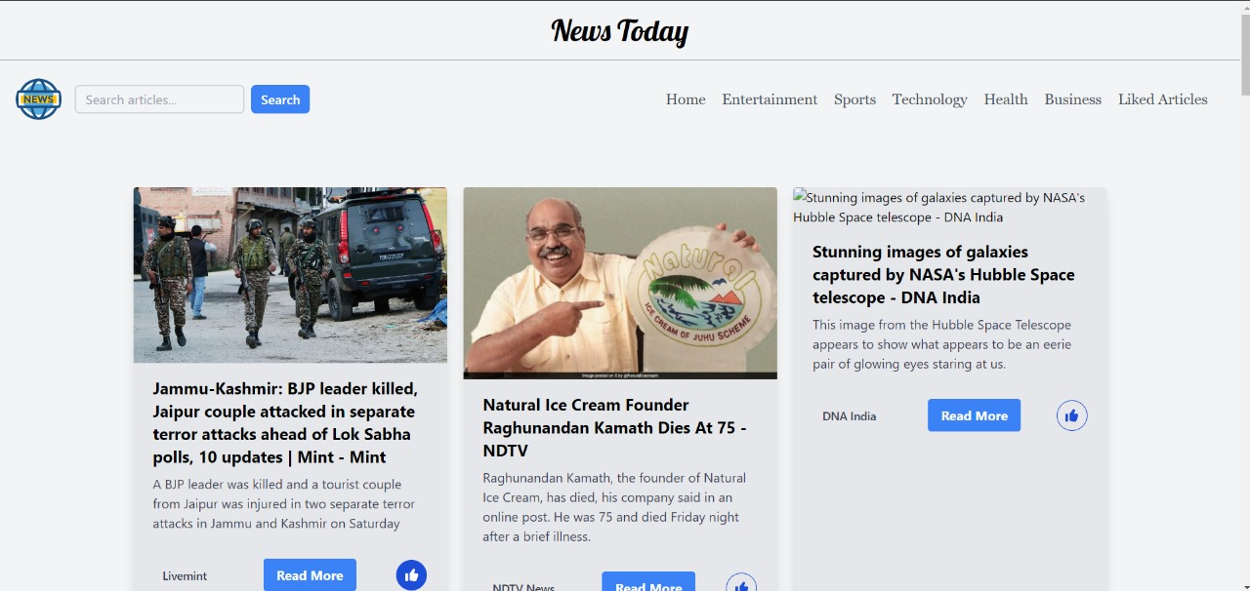
Results

Slide 17
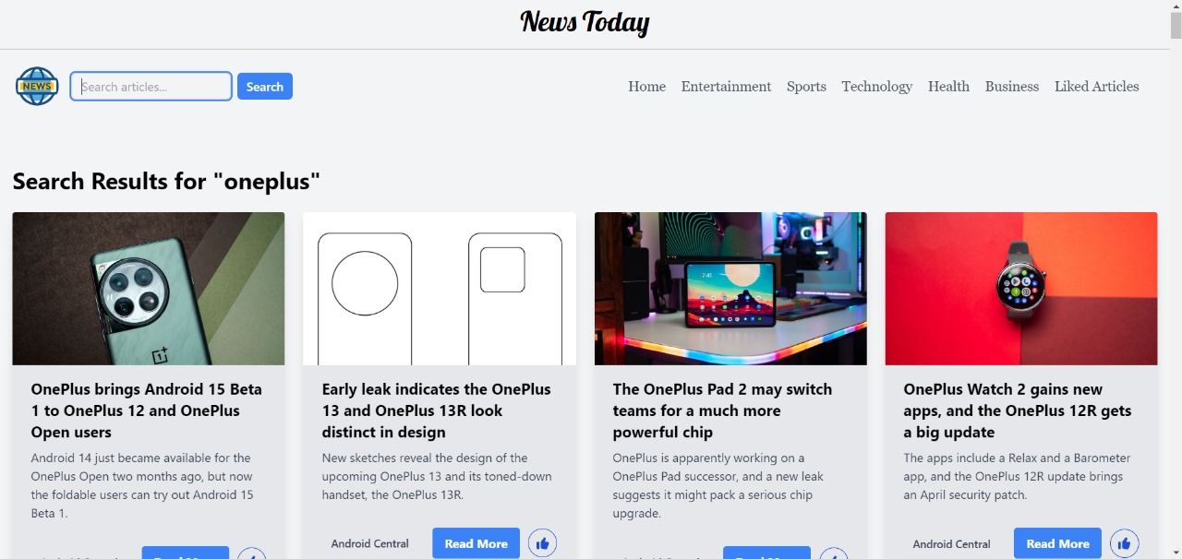

Slide 18
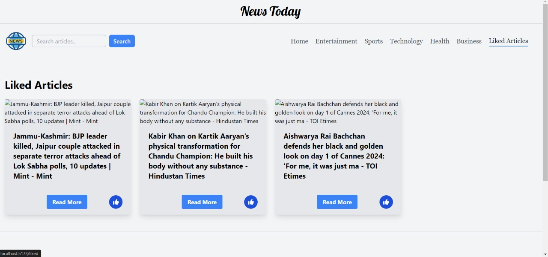

Slide 19
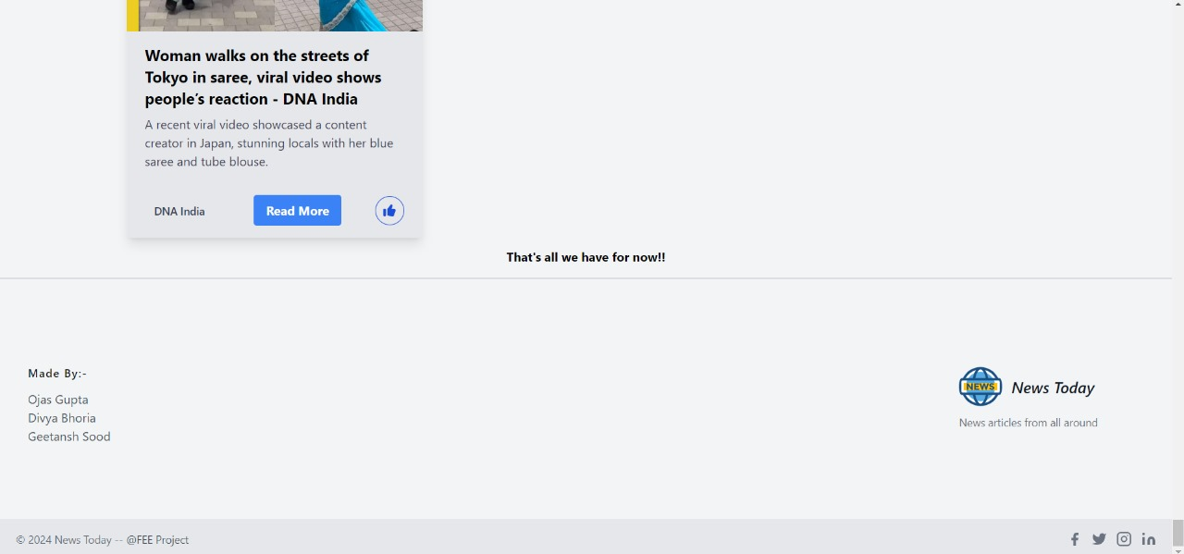

Slide 20
Conclusion
In conclusion, the development of a centralized news website utilizing HTML, CSS, React, Tailwind CSS, fonts, SVG, and report blocks represents a significant step forward in addressing the challenges of information overload, reliability concerns, and the proliferation of misinformation in today's digital age. By leveraging these technologies and design elements, the platform not only offers users a seamless and visually appealing browsing experience but also prioritizes functionality, accessibility, and credibility. Through the integration of Tailwind CSS for rapid styling, React for dynamic content rendering, and report blocks for user feedback and error reporting, the website ensures both convenience and reliability. Furthermore, the inclusion of diverse fonts and SVG graphics enhances the aesthetic appeal and user engagement. Overall, this innovative approach to news aggregation and presentation embodies a commitment to empowering users with convenient access to reliable, diverse, and visually captivating news coverage while promoting media literacy and fostering an informed and engaged society.

Slide 21
References
https://www.w3schools.com/html/default.asp
https://www.w3schools.com/css/default.asp
https://www.w3schools.com/react/default.asp
SVG Repo - Free SVG Vectors and IconsSVG Repohttps://www.svgrepo.com
Google Fonts: Browse FontsGoogle Fontshttps://fonts.google.com
https://tailblocks.cc/#google_vignette
React TutorialGeeksforGeekshttps://www.geeksforgeeks.org › react-tutorial
https://www.geeksforgeeks.org/what-is-react-router-dom/
https://flowbite.com/docs/components/buttons/

Slide 22


